Slide 1


ITC Hotels Revenue Optimization
Presented by: Shivani Awasthi

Slide 2

Quick Overview:
ITC Hotels is a luxury hotel chain that operates multiple properties with diverse room categories and varying occupancy rates. The company wants to gain deeper insights into its overall financial performance, customer booking behaviour, occupancy trends, and room category performance to optimize revenue generation, minimize cancellations, and enhance customer satisfaction. We have created a dashboard which gives a real time insights for decision-making.

Slide 3
Table of Contents
Objectives
Dashboards
Key insights
Conclusions and Suggestions

Slide 4
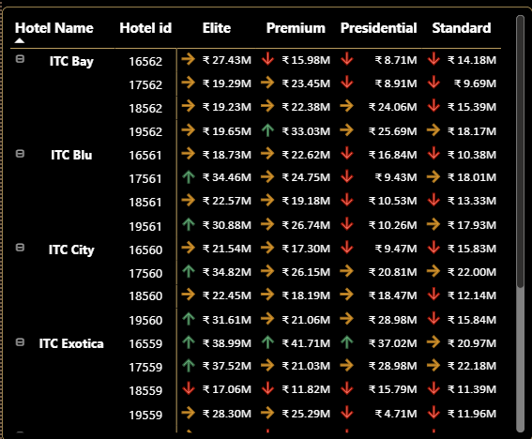

Objective: What is the total revenue generated by ITC Hotels, and how does it vary across different hotels and room categories?
Financial Overview & Revenue Performance
Solution:
To achieve the above I have created a measure which calculate the total revenue by using Sum and then used matrix to show total revenue generated by each hotels and room categories.

Slide 5

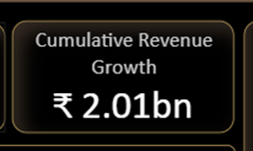
Objective: What is the cumulative revenue growth over time?
Financial Overview & Revenue Performance
Solution:
CALCULATED [revenue_generated] with
FILTER(ALL('calendar’), ---) removes existing filters on the calendar table, allowing the calculation to consider all dates, not just the filtered subset.
'calendar'[Date] <= MAX('calendar'[Date]) creates a running total logic, where revenue is summed up to the current date in the context.

Slide 6
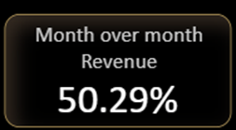
Objective: How has the revenue grown month-over-month (MoM) and week-over-week (WoW)?
Financial Overview & Revenue Performance
Solution:
MoM:
VAR prev_month: Retrieves revenue from the same date context, but shifted back by 1 month using DATEADD.
RETURN DIVIDE(): Calculates the difference between current and previous month's revenue. Divides the difference by the previous month's revenue. Used DIVIDE(_, _, 0) to avoid errors from division by zero — returns 0 instead.

Slide 7
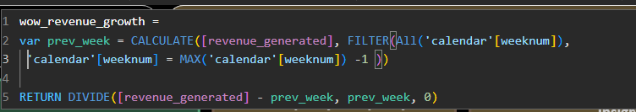
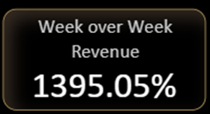
Objective: How has the revenue grown month-over-month (MoM) and week-over-week (WoW)?
Financial Overview & Revenue Performance
Solution:
WoW:
VAR prev_week: Retrieves the revenue total from the previous week. Used FILTER(ALL()) to ignore current filters and find the exact previous week using weeknum.
RETURN DIVIDE():Computes the difference between current and previous week's revenue. Divided by the previous week’s revenue to get a percentage. Returns 0 if the previous week’s revenue is zero (to avoid divide-by-zero errors).

Slide 8
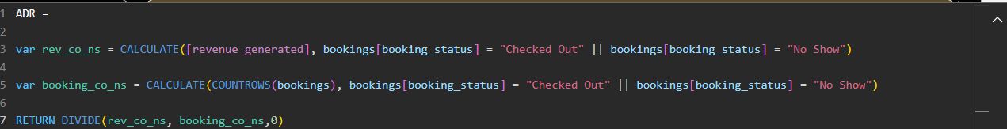
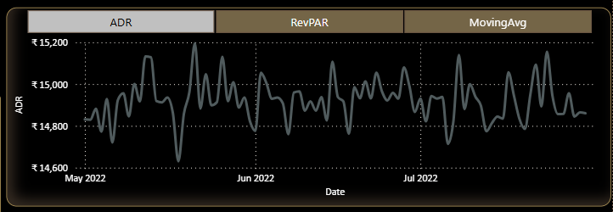
Objective: What are the average daily rate (ADR) and revenue per available room (RevPAR)?
Financial Overview & Revenue Performance
Solution:
ADR:
Created a measure and then used Line chart to display ditails.
rev_co_ns: Total revenue where booking_status is either "Checked Out" or "No Show"
booking_co_ns: Total number of bookings with those statuses
DIVIDE(): Returned the average revenue per qualifying booking. Used 0 as the fallback to avoid division by zero

Slide 9
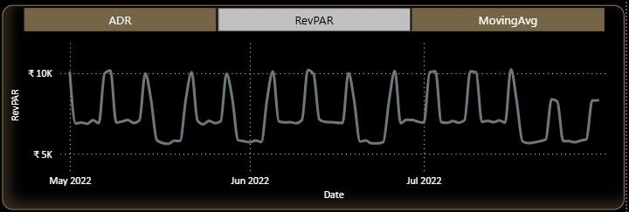
Objective: What are the average daily rate (ADR) and revenue per available room (RevPAR)?
Financial Overview & Revenue Performance
Solution:
RevPAR: Created a measure and then used Line chart to display ditails.
Numerator:[revenue_realised] - Total actual revenue earned from bookings
Denominator: SUM(occupancy[capacity]) - Total number of available rooms (capacity) in the given time period.
DIVIDE(): Safely performs the division, returning 0 if capacity is 0.

Slide 10
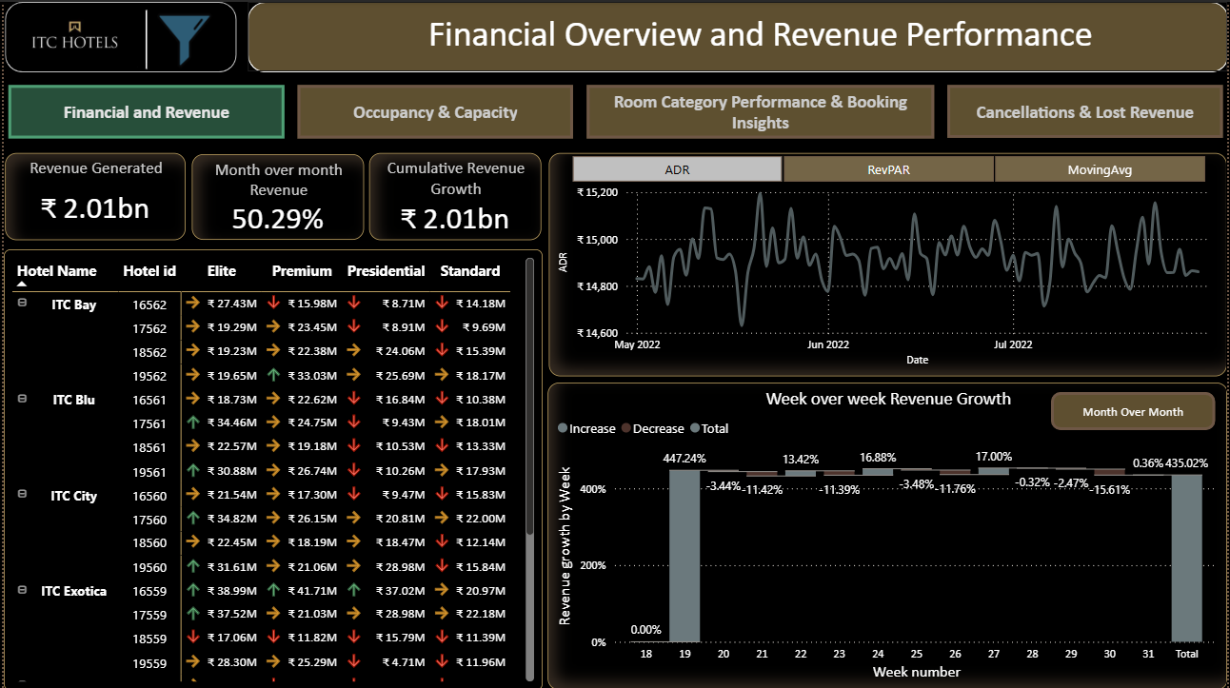

Slide 11
Key insights
Financial Overview & Revenue Performance
1. Revenue Performance
Total Revenue Generated: ₹2.01 billion.
Month-over-Month (MoM) Revenue Growth: 50.29%, which is a strong growth indicator.
The highest earning property is ITC Exotica with ₹37,47,11,225 in total revenue.
2. Segment-Wise Revenue
The Elite and Premium room categories generate significantly more revenue compared to Standard and Presidential categories.
However, some Premium and Standard rooms show declining trends (marked with red arrows).
3. Trends in ADR and revPAR
ADR (Average Daily Rate) is relatively stable.
revPAR (Revenue per Available Room) shows weekly cyclical patterns with spikes and dips, suggesting a weekend/week start trend.
4. WoW (Week-over-Week) Revenue Growth
A spike in week 22, 24 and week 27.
Mostly small increases/decreases in other weeks.
Indicates possibly seasonal promotions or events causing surges in demand.

Slide 12
Conclusions
Financial Overview & Revenue Performance
Strong Overall Performance:
The hotel portfolio is performing well, with solid MoM growth and a healthy top-line revenue.
High Variability Among Properties:
Some properties (e.g., ID 18558, 17558) are significantly outperforming others.
Week-on-Week Revenue Volatility:
Certain weeks exhibit extreme spikes, possibly due to high-impact factors (e.g., holidays, events).
Product Mix Dependency:
Revenue seems driven more by Elite and Premium categories, hinting at higher profitability in premium offerings.

Slide 13
Suggestion
Financial Overview & Revenue Performance
Investigate Top-Performing Properties:
Analyze what drives success in properties like ITC Exotica and ITC Palace (e.g., location, services, pricing strategy).
Address Underperforming Segments:
Standard and some Presidential segments show declining revenue.
Consider revising pricing, improving service quality, or repositioning offerings in those segments.
Capitalize on Revenue Spikes:
Study the cause of Week 24 and 27 spikes (special events, holidays?).
Plan targeted marketing and promotions around similar future dates.
Dynamic Pricing Strategy:
Use ADR and revPAR trends to optimize pricing during low-demand periods.
Implement real-time pricing based on occupancy and competitive rates.
Monitor and Act on Weekly Trends:
Week-to-week changes are volatile—set up alerts or auto-adjustments based on performance thresholds.
Increase Focus on High-Rev Categories:
Promote Elite and Presidential rooms through upselling, loyalty programs, or corporate tie-ups.

Slide 14
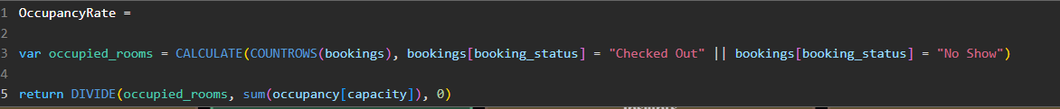
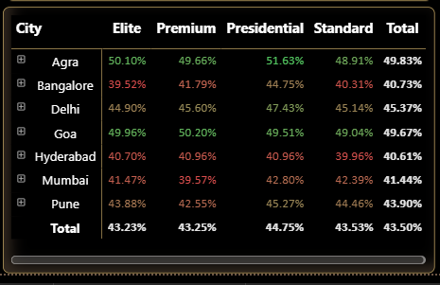
Objective: What is the occupancy rate for each hotel and room category?
Occupancy & Capacity Analysis
Solution:
Created a measure and then used Matrix to display the occupancy rate by hotel and room category.
occupied_rooms: Counts all bookings where booking_status is "Checked Out" or "No Show". Represents rooms that were intended to be used, regardless of whether the guest actually arrived.
SUM(occupancy[capacity]): Totals the number of available rooms (capacity) from the occupancy table.
DIVIDE(): Computes the ratio of occupied rooms to total capacity. Uses 0 as fallback to avoid divide-by-zero errors.

Slide 15
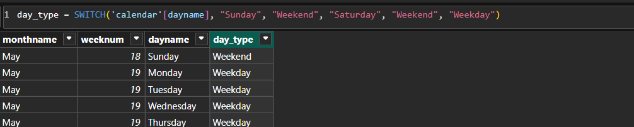
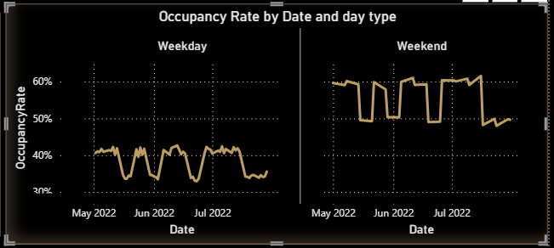
Objective: How does occupancy fluctuate seasonally or over specific periods (e.g., weekends, holidays)?
Occupancy & Capacity Analysis
Solution:
Created a new column using switch under the calendars table and then used chart to display the trends.

Slide 16

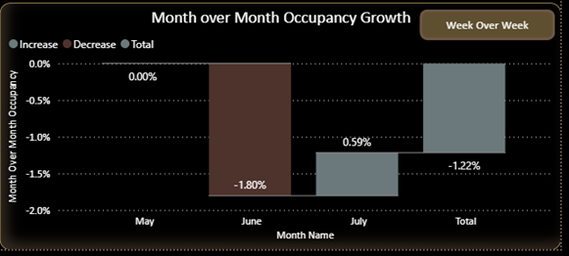
Objective: What is the occupancy growth (MoM and WoW)?
Occupancy & Capacity Analysis
Solution:
Calculate MOM using below measure and then used waterfall chart to display the growth
MoM:
VAR prev_month: Retrieves occupancy rate from the same date context, but shifted back by 1 month using DATEADD.
RETURN DIVIDE(): Calculates the difference between current and previous month's occupancy rate. Divides the difference by the previous month's occupancy rate. Used DIVIDE(_, _, 0) to avoid errors from division by zero — returns 0 instead.

Slide 17
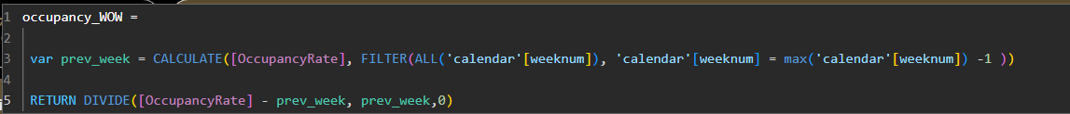
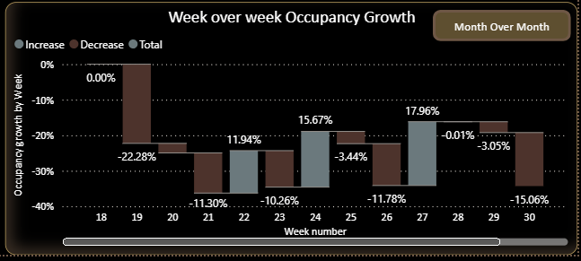
Objective: What is the occupancy growth (MoM and WoW)?
Occupancy & Capacity Analysis
Solution:
Calculate WOW using below measure and then used waterfall chart to display the growth
WoW:
VAR prev_week: Retrieves the Occupancy rate total from the previous week. Used FILTER(ALL()) to ignore current filters and find the exact previous week using weeknum.
RETURN DIVIDE():Computes the difference between current and previous week's Occupancy rate. Divided by the previous week’s Occupancy rate to get a percentage. Returns 0 if the previous week’s Occupancy rate is zero (to avoid divide-by-zero errors).

Slide 18
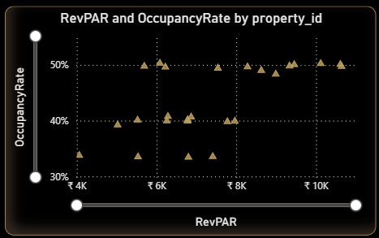
Objective: How does occupancy correlate with revenue and RevPAR?
Occupancy & Capacity Analysis
Solution:
Used previously created measure RevPAR and Occupancy Rate and display the corelation in scattered chart:

Slide 19
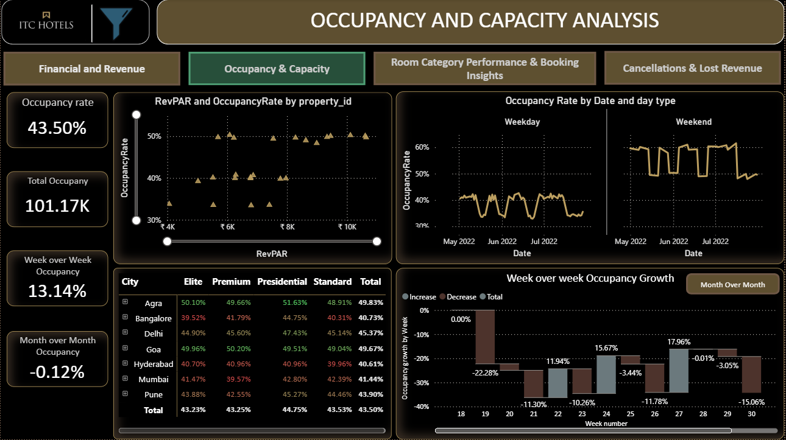

Slide 20
Key insights
Occupancy & Capacity Analysis
1 Overall Occupancy
Occupancy Rate: 43.50%
Total Occupancy: 101.17K bookings
Week-over-Week Occupancy Growth: 13.14% increase
Month-over-Month Occupancy Change: Slight decline of -0.12%
2. Occupancy Trends by Day Type
Weekday Occupancy: Generally lower, fluctuating around 35–40%
Weekend Occupancy: Higher and more stable, mostly above 50%
3. Occupancy vs RevPAR (Revenue per Available Room)
Properties with higher RevPAR generally show higher occupancy rates, though there are some outliers.
Significant cluster of properties in the ₹6K–₹10K RevPAR range with ~50% occupancy.
4. City and Room Category Performance
Top-performing city (Total Occupancy Rate): Goa (49.67%)
Lowest-performing city: Hyderabad (40.61%)
Best room category overall: Presidential (44.75%)
Lowest-performing room category: Premium (42.25%)
5. Week-over-Week Occupancy Growth (Trend)
High fluctuation observed:
Sharp declines: Week 20 (-22.28%), Week 30 (-15.06%)
Recovery spikes: Week 25 (15.67%), Week 27 (17.96%)

Slide 21
Conclusions
Occupancy & Capacity Analysis
Overall occupancy remains below optimal levels (ideally 60%+), with performance relying heavily on weekend traffic.
Occupancy growth is unstable, with high volatility week to week.
Premium and standard categories underperform, while Presidential and Elite rooms show stronger occupancy, possibly reflecting more value-driven or exclusive segments.
Hyderabad and Bangalore need immediate attention due to low total occupancy (<41%).

Slide 22
Suggestion
Occupancy & Capacity Analysis
1. Boost Weekday Occupancy
Launch weekday-specific promotions (e.g., business traveler packages, loyalty discounts).
Partner with corporates for mid-week business stays.
2. Stabilize Occupancy Growth
Analyze weeks with high drops (e.g., Week 20 & 30) for root causes (events, seasonality, pricing changes).
Implement dynamic pricing and forecasting tools to smooth demand across weeks.
3. City-Level Actions
Hyderabad: Consider localized marketing, revisiting pricing, or bundling services.
Goa: Leverage its top performance by introducing premium upselling, loyalty retention offers.
4. Improve Underperforming Categories
For Premium rooms:
Re-evaluate positioning and pricing.
Add perceived value (e.g., breakfast, free upgrades).
5. Monitor Revenue Correlation
Continue optimizing RevPAR vs Occupancy balance.
For properties with high RevPAR and low occupancy, experiment with marginal price drops to increase volume without eroding yield.

Slide 23

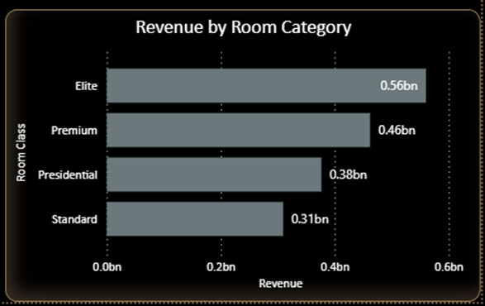
Objective: Which room categories generate the most revenue?
Room Category Performance & Booking Insights
Solution:
We have created measure to calculate the total revenue realised by using Sum and then used bar chart to display the top revenue generated room category.

Slide 24
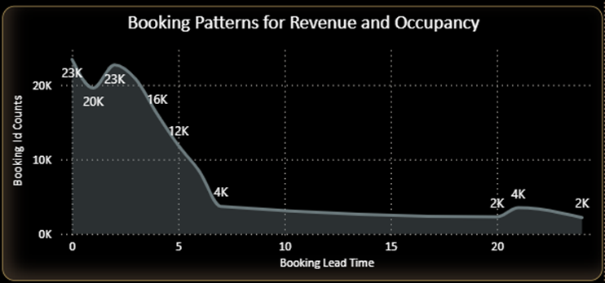
Objective: How do booking patterns (lead time, check-in dates) affect revenue and occupancy?
Room Category Performance & Booking Insights
Solution:
Created a calculated column to calculate the leadtime. Used DatedIff function. And then used line chart to display the booking patterns changes for revenue and occupancy.

Slide 25
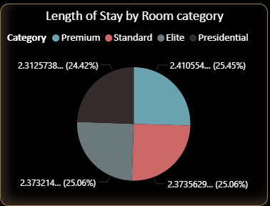
Objective: What is the average length of stay (ALOS) for each hotel and room type?
Room Category Performance & Booking Insights
Solution:
Created LOS measure and used Pie chart to display tit by each room category. Additional Provided filters to view it by Hotel name or hotel id.

Slide 26
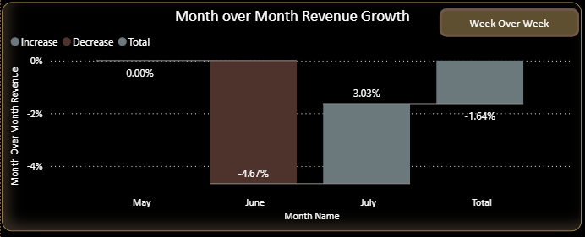
Objective: What is the room revenue trend (including running total and MoM/WoW growth)?
Room Category Performance & Booking Insights
Solution:
MoM:
VAR prev_month: Retrieves revenue from the same date context, but shifted back by 1 month using DATEADD.
RETURN DIVIDE(): Calculates the difference between current and previous month's revenue. Divides the difference by the previous month's revenue. Used DIVIDE(_, _, 0) to avoid errors from division by zero — returns 0 instead.

Slide 27
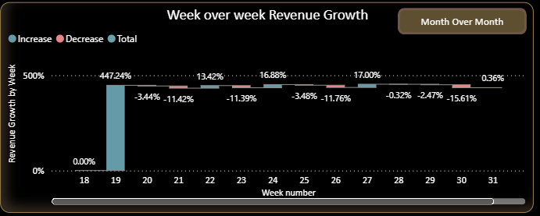
Objective: What is the room revenue trend (including running total and MoM/WoW growth)?
Room Category Performance & Booking Insights
Solution:
WoW:
VAR prev_week: Retrieves the revenue total from the previous week. Used FILTER(ALL()) to ignore current filters and find the exact previous week using weeknum.
RETURN DIVIDE():Computes the difference between current and previous week's revenue. Divided by the previous week’s revenue to get a percentage. Returns 0 if the previous week’s revenue is zero (to avoid divide-by-zero errors).

Slide 28
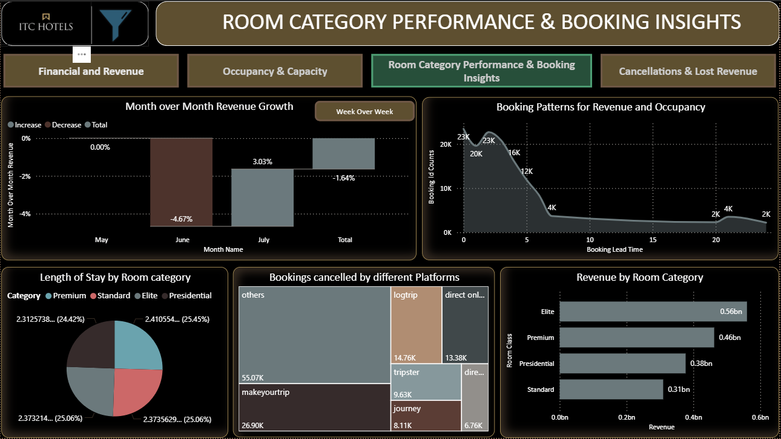

Slide 29
Key insights
Room Category Performance & Booking Insights
🔸 Revenue and Booking Behavior
Most bookings are made with short lead times (under 5 days), and these contribute the most to revenue and occupancy.
Sharp drop in both revenue and occupancy when lead time exceeds 10 days.
🔸 ALOS by Room Category
Highest ALOS: Presidential (2.41 days)
Lowest ALOS: Elite (2.31 days)
ALOS is fairly consistent across categories (2.31–2.41 days), indicating short stays dominate across the board.
🔸 Month-over-Month Revenue Growth (by Room Category)
June shows a significant dip across most categories.
July shows recovery, especially in Elite and Presidential categories.
🔸 Week-over-Week Revenue Growth (by Room Category)
High volatility with a sharp peak around Week 19 (400%+ growth), then a flat and stable trend afterward.
🔸 Total Revenue by Room Category
Elite leads with ₹560M
Followed by:
Premium: ₹462M
Presidential: ₹377M
Standard: ₹310M

Slide 30
Conclusions
Room Category Performance & Booking Insights
1. Booking Behavior is Short-Term:
Customers book close to the date of stay, indicating spontaneous or last-minute travel behavior.
2. Short Stay Duration is Standard:
With an average of ~2.37 days, this suggests the portfolio is mostly targeting transient travelers rather than long-stay or extended vacationers.
3. Revenue Concentrated in Elite & Premium Segments:
These segments contribute the majority of revenue, indicating strong demand for high-end offerings.
4. July Recovery After June Dip:
Likely seasonal or promotion-based impact; July shows strong bounce-back especially for high-end rooms.
5. Week 19 Spike is an Outlier:
Possibly driven by a special event, campaign, or anomaly.

Slide 31
Suggestion
Room Category Performance & Booking Insights
Optimize Booking Window Strategy
Target users booking within 3–5 days with dynamic pricing and last-minute offers.
Consider push marketing (SMS/app) for flash deals around this short booking window.
🏷️ Enhance High-Performing Segments
Double down on Elite and Premium offerings:
Upsell with value-add services (late checkout, meals, airport transfer).
Highlight them in campaigns during peak demand months (e.g., July).
📉 Address June Dip
Investigate causes for June revenue drop (e.g., price changes, external events, seasonality).
Introduce early-bird campaigns in May to lock in June stays.
🧭 Explore Longer-Stay Incentives
Average stay is low; consider promotions for extended stays (e.g., “Stay 3 nights, get 4th free”).
Target business travelers who might be open to bundled longer stays.
📈 Analyze Week 19 Peak
Understand what drove the massive Week 19 growth:
Was there a major holiday, event, or promotion?
Replicate the strategy if possible.

Slide 32

Objective: What is the cancellation rate for each hotel and room category?
Cancellations & Lost Revenue Analysis
Solution:
To find out the Cancellation rate we have divided cancelled booking to the total bookings.

Slide 33

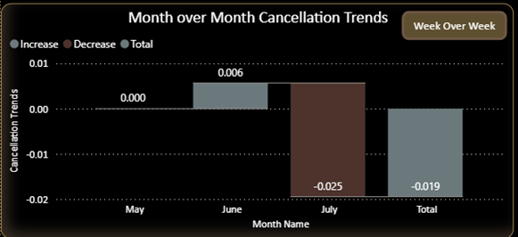
Objective: How have cancellation trends changed over time (MoM/WoW)?
Cancellations & Lost Revenue Analysis
Solution:
Calculate MOM using below measure and then used waterfall chart to display the Cancellation trends
MoM:
VAR prev_month: Retrieves cancellation rate from the same date context, but shifted back by 1 month using DATEADD.
RETURN DIVIDE(): Calculates the difference between current and previous month's cancellation rate. Divides the difference by the previous month's cancellation rate. Used DIVIDE(_, _, 0) to avoid errors from division by zero — returns 0 instead.

Slide 34
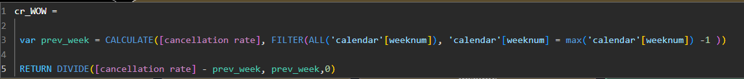
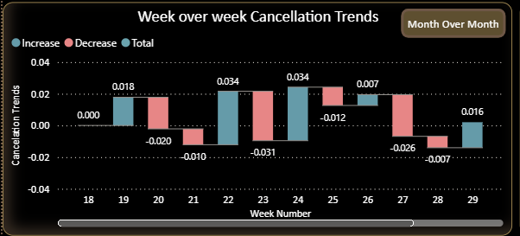
Objective: How have cancellation trends changed over time (MoM/WoW)?
Cancellations & Lost Revenue Analysis
Solution:
Calculate WOW using below measure and then used waterfall chart to display the cancellation rate
WoW:
VAR prev_week: Retrieves the cancellation rate total from the previous week. Used FILTER(ALL()) to ignore current filters and find the exact previous week using weeknum.
RETURN DIVIDE():Computes the difference between current and previous week's cancellation rate. Divided by the previous week’s cancellation rate to get a percentage. Returns 0 if the previous week’s cancellation rate is zero (to avoid divide-by-zero errors).

Slide 35
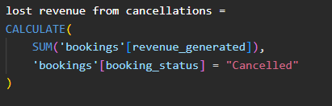

Objective: What is the lost revenue due to cancellations?
Cancellations & Lost Revenue Analysis
Solution:
To calculate the lost revenue from cancellation, we have used the calculate function where we have count the total of revenue generated from booking table by applying the filter where booking status is cancelled.

Slide 36
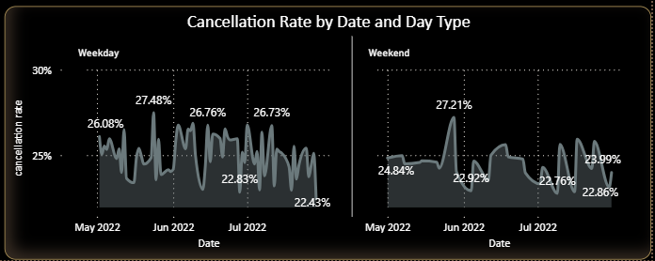
Objectives: Are there any patterns in cancellations (e.g., specific room types, time of year)?
Cancellations & Lost Revenue Analysis
Solutions: To display the patterns in cancellation we have used line chart with days and date and provided filters to view it for specific room type or hotel.

Slide 37
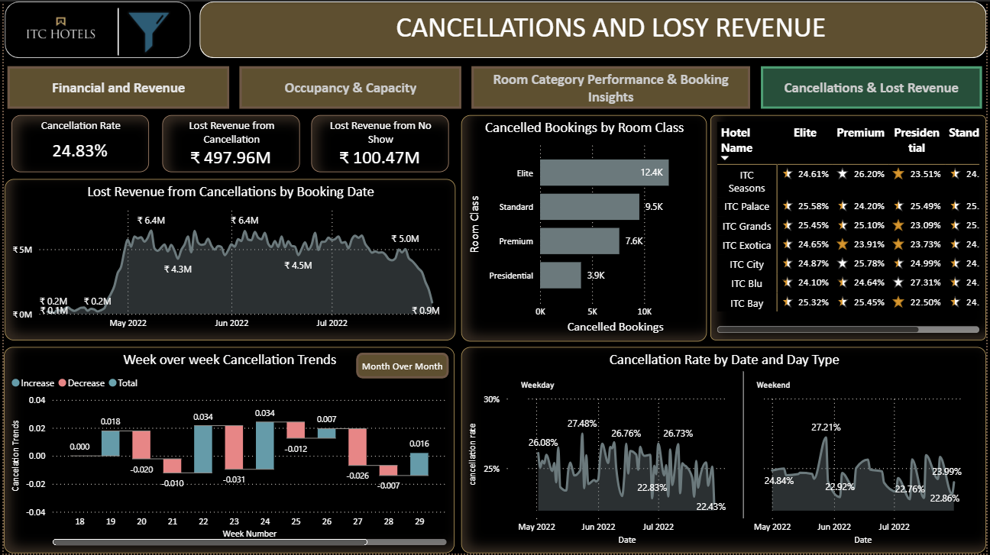

Slide 38
Key insights
Cancellations & Lost Revenue Analysis
🔸 High-Level Metrics
Cancellation Rate: 24.83%
Lost Revenue from no show : 100.47M
Revenue Lost Due to Cancellations: 199.18M
🔸 Cancellation Rate by Property
Cancellation rates are fairly consistent across top properties:
Ranging from 24.37% (ITC Blu) to 25.18% (ITC Palace)
No property stands out with abnormally high or low rates — indicates a systemic issue rather than location-specific.
🔸 Cancellation Trends by Date and Month
Date Trend (May to July 2022):
Fluctuates between 22% and 28%
Shows high variability, particularly in June
Month-over-Month Change:
June saw a slight increase (+0.57%)
July experienced a notable decrease (-2.51%), indicating possible stabilization
🔸 Week-over-Week Cancellation Growth
Cancellation rate spiked in Week 23 (3.38%)
Followed by slight increases/decreases, with some weeks showing recovery (e.g., Week 24 and Week 30)
Volatile pattern, especially around Weeks 22–25
🔸 Cancellation by Room Category
Very little variance across room types:
Elite: 12.4k
Standard: 9.5K
Premium: 7.6K
Presidential: 3.9K
Suggests that cancellations are not influenced by room type.

Slide 39
Conclusions
Cancellations & Lost Revenue Analysis
1. High Cancellation Rate Impacting Revenue
A 24.83% cancellation rate resulting in ₹199M in lost revenue is significant, affecting operational planning and financial performance.
2. Issue is System-Wide
Similar cancellation rates across properties and room categories suggest that the cause is not location- or room-specific.
3. Peak in June Followed by July Recovery
Indicates potential for corrective measures taken in July that led to a slight drop in cancellations.
4. Recent Volatility Must Be Addressed
The sharp WoW growth signals an abnormal event or trend that warrants further investigation.

Slide 40
Suggestion
Cancellations & Lost Revenue Analysis
Implement Cancellation Policy Adjustments
Introduce tiered cancellation policies (e.g., non-refundable vs. flexible rates) to manage risk.
Consider deposit requirements or penalty windows for peak periods.
📞 Improve Customer Communication
Many cancellations stem from lack of clarity or change of plans.
Ensure automated reminders, cancellation policy visibility, and pre-stay incentives (e.g., discounts for confirmed stays).
📉 Analyze High Volatility Weeks (22–25)
Deep-dive into these weeks:
Was there a pricing change, weather event, or travel restriction?
Use learnings to anticipate and mitigate future spikes.
🎯 Targeted Interventions in High-Risk Periods
Run confirmation campaigns 2–3 days before check-in, especially for bookings made far in advance.
Consider retargeting canceled users with offers for future stays.
📅 Monitor A/B Tests for July Improvements
July showed a dip in cancellations. Understand:
Were there policy changes?
Were new booking incentives launched?
Scale what worked in July across other months.

Slide 41

Presented by: Shivani Awasthi
Mentored by: Ayushi Jain

